Slide 1
AWS Compute

Slide 2
AWS EC2
Amazon Elastic Compute Cloud (Amazon EC2) is a web service that provides secure, resizable compute capacity in the cloud. It is designed to make web-scale cloud computing easier for developers.

Slide 3
AWS EC2 Pricing Models
Amazon EC2 Spot Instances
Amazon EC2 Reserved Instances
Amazon EC2 Dedicated Hosts
Amazon EC2 On-Demand Instances

Slide 4
Amazon EC2 Spot Instances
To use Spot Instances, create a Spot Instance request or a Spot Fleet request. The request can include the maximum price that you are willing to pay per hour per instance (the default is the On-Demand price), and other constraints such as the instance type and Availability Zone. If your maximum price exceeds the current Spot price for the specified instance, and capacity is available, your request is fulfilled immediately. Otherwise, the request is fulfilled whenever the maximum price exceeds the Spot price and the capacity is available. Spot Instances run until you terminate them or until Amazon EC2 must interrupt them (known as a Spot Instance interruption).

Slide 5
AMAZON EC2 Reserved Instances
A Reserved Instance is a reservation of resources and capacity, for either one or three years, for a particular Availability Zone within a region. Unlike on-demand, when you purchase a reservation, you commit to paying for all of the hours of the 1- or 3-year term; in exchange, the hourly rate is lowered significantly.

Slide 6
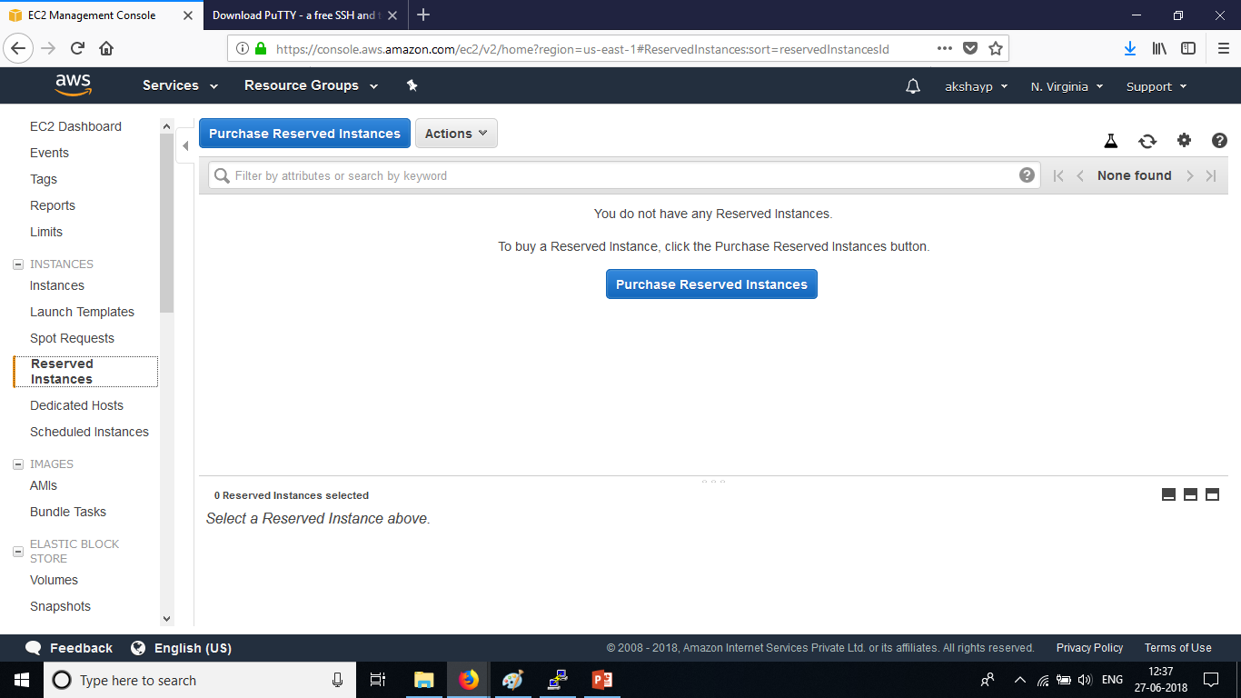
Where to view reserved instances on the management console?

Slide 7
Amazon EC2 Dedicated Hosts
An Amazon EC2 Dedicated Host is a physical server with EC2 instance capacity fully dedicated to your use. Dedicated Hosts can help you address compliance requirements and reduce costs by allowing you to use your existing server-bound software licenses
Benefits :
Save money on licensing costs.
Help Meet Compliance and Regulatory Requirements

Slide 8
Amazon EC2 On-Demand Instances
Dedicated Instances are Amazon EC2 instances that run in a VPC on hardware that's dedicated to a single customer. Your Dedicated instances are physically isolated at the host hardware level from instances that belong to other AWS accounts. Dedicated instances may share hardware with other instances from the same AWS account that are not Dedicated instances.

Slide 9
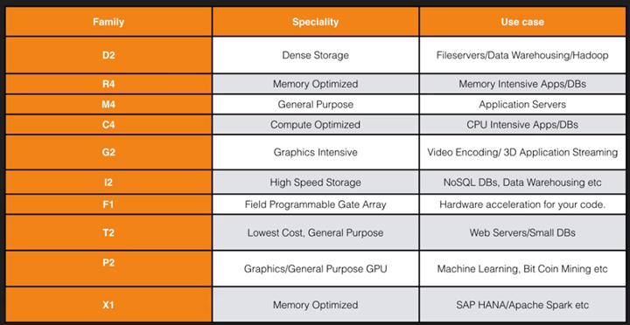
Amazon ec2 instance types
EC2 Instance Types

Slide 10
s
AWS EC2 Instance Volume Types
General Purpose SSD (gp2) : It balances price performance for a wide variety of transactional workloads.
Provisioned IOPS SSD (io1) : Highest performance SSD volume designed for latency-sensitive transactional workloads.
Throughput Optimized HDD (st1) : Low cost HDD volume designed for frequently accessed, throughput intensive workloads
Cold HDD (sc1) : Lowest cost HDD volume designed for less frequently accessed workloads.

Slide 11
AMI : Amazon Machine Image
An Amazon Machine Image (AMI) provides the information required to launch an instance, which is a virtual server in the cloud. You must specify a source AMI when you launch an instance. You can launch multiple instances from a single AMI when you need multiple instances with the same configuration. You can use different AMIs to launch instances when you need instances with different configurations.
An AMI includes the following:
A template for the root volume for the instance (for example, an operating system, an application server, and applications)
Launch permissions that control which AWS accounts can use the AMI to launch instances
A block device mapping that specifies the volumes to attach to the instance when it's launched

Slide 12
SSH
SSH?
SSH, also known as Secure Socket Shell, is a network protocol that provides administrators with a secure way to access a remote computer. SSH also refers to the suite of utilities that implement the protocol.
To SSH into an EC2 instance
Linux : Open Terminal . Type ssh ec2-user@<Public IPV4> -i <PrivateKey>
Windows : Use Putty and PuttyGen

